Slide 1
Introduction To Programming

Slide 2
Content
OOP
Classes & Objects
Multiple Objects
Methods
Methods with parameters

Slide 3
OOP
OOP stands for Object-Oriented Programming.
Procedural programming (POP) is about writing procedures or functions that perform operations on the data, while object-oriented programming is about creating objects that contain both data and functions.
Object-oriented programming has number of benefits over procedural programming:
OOP is faster and easier to execute
OOP provides a clear structure for the programs
OOP helps to make the code easier to maintain, modify and debug
OOP makes it possible to create full reusable applications with less code and shorter development time

Slide 4
OOP...
It is necessary to understand some of the basic concepts used extensively in object-oriented programming.
Class
Object
Abstraction
OOP
Inheritance
Encapsulation
Polymorphism

Slide 5
Classes and Objects
The two main components of object-oriented programming are classes and objects.
Class
Course
Objects
C++
Java
C#
Class
Snacks
Objects
Burger
Sandwich
Pizza

Slide 6
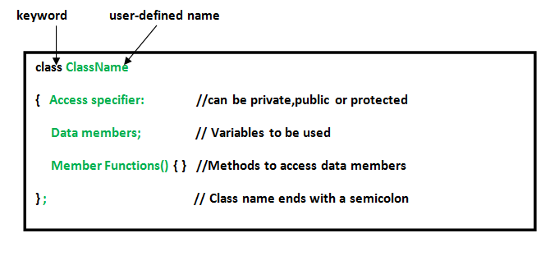
Classes and Objects...
Class - A class can be defined as a template/blueprint that describes the behavior/state that the object of its type support.
Object - An object is an instance of a class. Objects have states and behaviors.

Slide 7
Classes and Objects...
Everything in C++ is associated with classes and objects, along with its attributes and methods.
Class
Vehicle
Objects
Car
Attributes
Weight
Color
Methods
Drive
Brake
Class Members
Variables & Functions

Slide 8
Create a Class
class MyClass // The class
{ public: // Access specifier int number; // Attribute (int variable) string name; // Attribute (string variable) };
The public keyword is an access specifier, which specifies that members (attributes and methods) of the class are accessible from outside the class.
class Car // The class
{ public: // Access specifier int weight; // Attribute (int variable) string color; // Attribute (string variable) };

Slide 9
Create an Object
#include <iostream>
using namespace std;
class MyClass { // The class
public: // Access specifier
int cId; // Attribute (int variable)
string cName; // Attribute (string variable)
};
int main() {
MyClass myObj; // Create an object of MyClass
// Access attributes and set values
myObj.cId = 101;
myObj.cName = "C++";
// Print values
cout << myObj.cId << "\n";
cout << myObj.cName;
return 0;
}
Syntax-
ClassName ObjectName;

Slide 10
Multiple Objects
#include <iostream>
using namespace std;
class Course {
public:
int cId;
string cName;
};
int main() {
Course CS;
CS.cId = 101;
CS.cName = "C++";
Course EEE;​
​
EEE.cId = 102;​
EEE.cName = "DLD";​
​
​
cout << CS.cId <<","<<CS.cName<<"\n";​
cout << EEE.cId <<","<<EEE.cName;​
​
return 0;​
}​
​

Slide 11
Class Methods
Methods are functions that belongs to the class.
There are two ways to define functions that belongs to a class:
Inside class definition
Outside class definition
#include <iostream>
using namespace std;
class MyClass { // The class
public: // Access specifier
void myMethod() {
// Method/function defined inside the class
cout << "I am learning Methods";
}
};
int main() {​
MyClass myObj; // Create an object of MyClass​
myObj.myMethod(); // Call the method​
return 0;​
}

Slide 12
Class Methods...
#include <iostream>
using namespace std;
class MyClass { // The class
public: // Access specifier
void myMethod(); // Method/function declaration
};
// Method/function definition outside the class
void MyClass::myMethod() //scope resolution operator
{
cout << "I am Learning Methods";
}
​
int main() {​
MyClass myObj; // Create an object of MyClass​
myObj.myMethod(); // Call the method​
return 0;​
}

Slide 13
Class Methods (Parameters)
#include <iostream>
using namespace std;
class Student {
public:
int sNumber(int maxStudent);
};
int Student::sNumber(int maxStudent)
{
return maxStudent;
}
int main() {​
Student myObj;​ // Create an object of Student
cout << myObj.sNumber(40);​ // Call the method with an argument
return 0;​
}​

Slide 14
Class Methods (Parameters)...
class Person
{
public:
int NID;
string VaccineName;
void display()
{
cout<< "NID No:"<<NID<<","<<"Vaccine Name:"<<VaccineName<<endl;
}
void setValue(int a, string b)
{
NID = a;
VaccineName = b;
}
};
int main ()
{
Person Obj;
Obj.setValue(2349824, "Verocell");
Obj.display();
return 0;
}

